Slide 1
Presenter Name
Supervised by
Prof .Dr/ Effat ElKarmalawy
Prof .Dr/ Enas Helmy
Assist. Prof/ Heba Ahmed
Prepared by:
Maha Ibrahim Esraa Saied

Slide 2
Objectives
Describe the importance of fairness in testing.
Recognize the code in the testing practices.
Analyze the four key areas of the code.

Slide 3
Outlines
Introduction.
Definition of Fairness.
Definition of The code of fair testing practices.
Purposes of The code of fair testing practices.

Slide 4
Outlines cont.,
Guidance areas of the code:
A-Developing and selecting appropriate test
B-Administering and scoring Tests.
C-reporting and interpreting Test Results
D-Informing Test Takers
Conclusion.

Slide 5
Introduction
Assessment and evaluation are fundamental components of education, serving as tools to measure learning, guide instruction, and make critical decisions about students' progress. However, the fairness, validity, and ethical use of these assessments are just as important as the assessments themselves. The Code of Fair Testing Practices in Education was developed to ensure that tests and other evaluation methods are administered, interpreted, and used in ways that are equitable, transparent, and free from bias (Zlatkin et al ,2021).
.

Slide 6
Definition of code of fair testing practice
The Code of Fair Testing Practices in Education is a set of guidelines developed by professional organizations (e.g., AERA, APA, NCME) to ensure fairness in educational assessments(Stone& Cook,2020).

Slide 7
Fairness
•Fairness is a primary consideration in all aspects of testing.
•Careful standardization of tests and administration conditions helps to ensure that all test-takers are given a comparable opportunity to demonstrate what they know and how they can perform in the area being tested.
•Fairness implies that every test-taker has the opportunity to prepare for the test and is informed about the general nature and content of the test, as appropriate to the purpose of the test
(Stone& Cook,2020).

Slide 8
The code of fair testing practices:
The Code is directed primarily at professionally developed tests used in formally administered testing programs.
Although the Code is not intended to cover tests made by teachers for use in their own classrooms, teachers are encouraged to use the guidelines to help improve their testing practices.
The Code applies broadly to testing in education (admissions, educational assessment, educational diagnosis, and student placement) regardless of the mode of presentation
It is not designed to cover employment testing, licensure or certification testing, or other types of testing outside the field of education.
It is relevant to conventional paper-and-pencil tests, computer-based tests, and performance tests.

Slide 9
The code of fair testing practices cont.,
The Code addresses the roles of test developers and test users separately.
Test developers are people and organizations who construct tests, as well as those who set policies for testing programs.
Test users are people and agencies who select tests, administer tests, commission test development services, or make decisions on the basis of test scores.
Test takers are people who take the test.

Slide 10
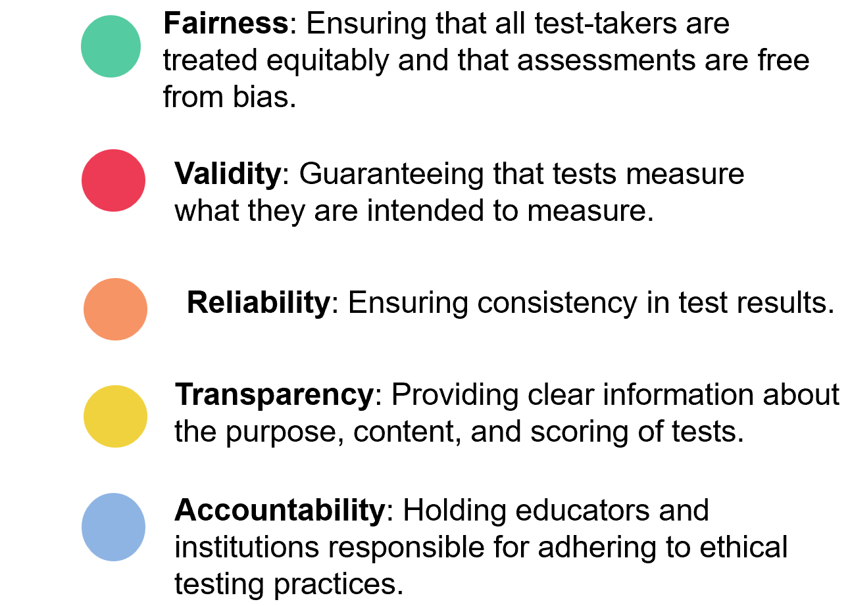
Key objectives of the code of fair testing practices
Walt Disney

Slide 11
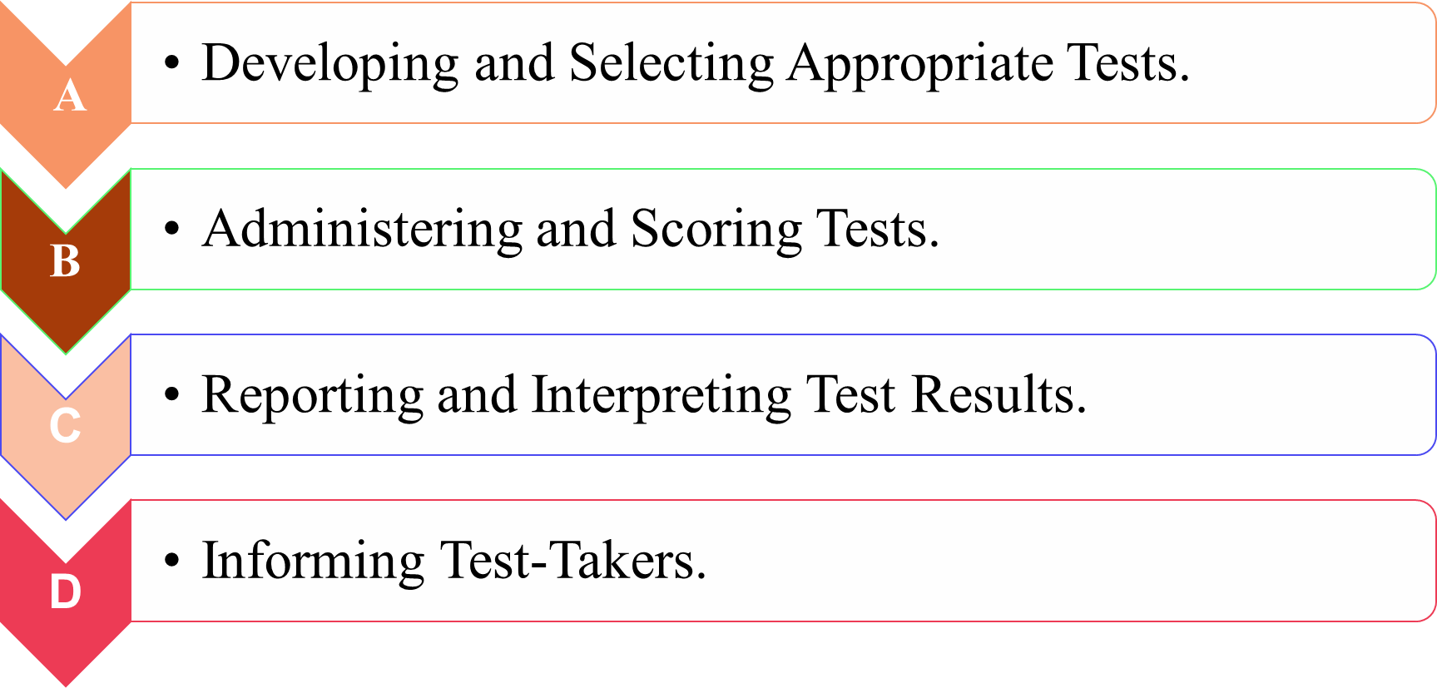
Guidance Areas of The Code

Slide 12
Developing and Selecting Appropriate Tests
Category | Test Developers | Test Users | Test Takers
Purpose & Evidence | -Provide evidence of test measures, recommended uses, intended test takers, strengths/limitations, and precision -Describe content/skill selection and test development process | -Define testing purpose, content/skills, and intended test takers. -Select tests based on thorough review. Review materials for clarity/accuracy | Inform test takers in advance about test coverage, question formats, directions, and test-taking strategies
Technical Quality | -Provide evidence of reliability/validity. -Share samples of questions, manuals, and score reports | Evaluate technical quality and samples | Access to test information, complain, or resolve technical issues.
Inclusivity & Fairness | -Avoid offensive content -Provide accommodations for disabilities. -Obtain diverse subgroup performance data | -Evaluate fairness and select accommodated tests - Analyze subgroup performance | Request accommodations if needed
Selection Process | -Communicate test characteristics appropriately -Guide required knowledge/training for test use | Involve qualified personnel in selection | For optional tests, provide information to help decide whether to take it, including consequences of not taking it and alternatives

Slide 13
Administering and Scoring Tests
Category | Test Developers | Test Users | Test Takers
Standardization | Provide detailed administration procedures . | Follow standardized procedures . | -Follow test rules -Disclose rights to access tests/answer sheets, retake, rescore, or invalidate scores.
Accommodations | Offer guidelines for disabilities/linguistic diversity | Document accommodations | Disclose needs for accommodations.
Test Familiarity | Explain question formats/equipment | Allow practice with formats/materials | Engage with practice materials.
Security & Scoring | -Ensure test security -Provide scoring guidelines/training | -Protect materials - Train scorers | Explain how long scores are kept, who can access them, and privacy protections.
Accuracy & Confidentiality | -Correct errors promptly -Ensure score confidentiality | -Correct errors -Protect confidentiality | Clarify responsibilities like understanding test purposes, performing honestly, and not disclosing items.

Slide 14
Reporting and Interpreting Results
Category | Test Developers | Test Users | Test Takers
Interpretation | -Support interpretations with evidence -Warn against misuse ( | -Interpret results with technical context -Avoid unsupported uses | Understand limitations of results.
Modifications | -Guide interpretation of modified tests | -Account for modification impacts | Get notified in case of modification of scoring
Standards & Labels | -Justify performance standards -Avoid stigmatizing labels. | -Review standards -Avoid harmful labels. | Avoid jargons and offensive language while taking the test
Decision-Making | Advise multi-source decisions | Avoid single-score reliance | View results after final interpretation

Slide 15
Reporting and Interpreting Results Cont.,
Category | Test Developers | Test Users | Test Takers
Group Reporting | Provide group comparison data | Report group procedures/context | Reported result in comparison of norm groups
Communication | Deliver timely, understandable results | Communicate clearly | Review results carefully.
Monitoring Use | Guide monitoring of test purposes | Implement monitoring | Ensure monitoring of test aligns with personal and professional goals

Slide 16
Summary
The Code of Fair Testing Practices in Education serves as a vital ethical framework to ensure that assessments are valid, unbiased, and used responsibly. By adhering to principles of transparency, fairness, accessibility, and proper interpretation, educators and test developers can uphold integrity in evaluation processes.
Fair testing promotes equitable opportunities for all learners, minimizes discrimination, and ensures that assessments accurately reflect students' knowledge and abilities—not extraneous factors. As educators, it is our responsibility to implement these standards, advocate for ethical testing practices, and continuously evaluate assessments for potential biases or inequities.

Slide 17
References
Oermann, M. H., & Gaberson, K. B. (2020). Evaluation and testing in nursing education (4th ed.). Springer Publishing Company.

Slide 18
Thank you
Any Questions ?

